Slide 1


Workflow vs Agent-based Design
Exploring two distinct approaches for automating Kubernetes Operator upgrades using predictable Workflow model and adaptive Agent-based design.
by Kavinraja Ganesan

Slide 2
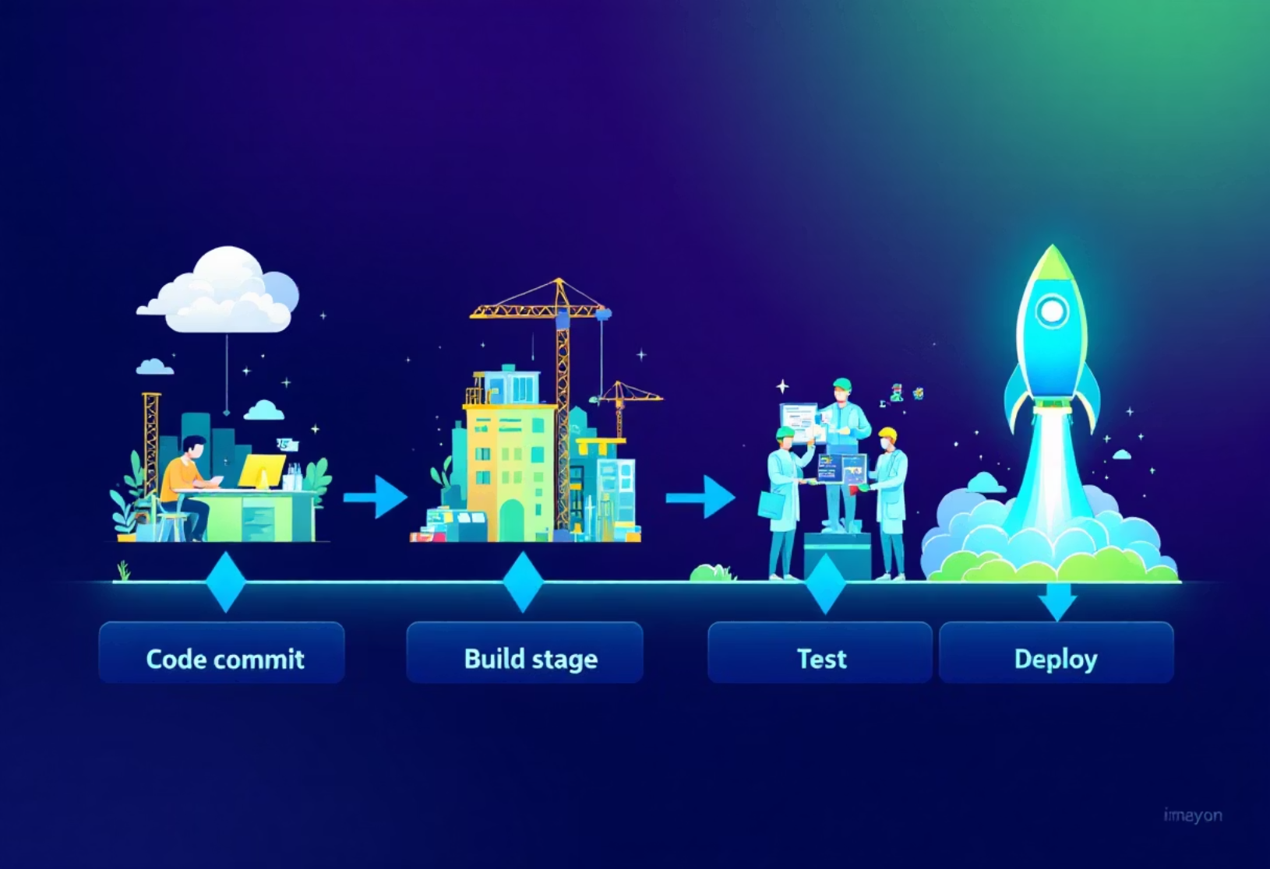
Workflow Design: Fixed K8s Operator Upgrade Pipeline
The workflow approach defines a rigid, pre-determined sequence for operator upgrades. Each step is explicitly coded, making the process highly reproducible and straightforward to debug.
Trigger & Validation
Monitors for new releases via webhooks or cron jobs, fetching changelog details.
Preflight & Execution
Backs up existing resources, then updates and applies Helm/Kustomize charts to staging.
Verification & Rollout
This method is ideal for routine, low-risk upgrades where the process is well-understood and rarely deviates. Error handling is typically hard-coded, ensuring predictable responses to common issues.
Runs smoke tests to ensure functionality, followed by a controlled promotion to production.

Slide 3





Agent Design: Dynamic Upgrade Agent for K8s Operators
Goal & Observation
Detects new operator releases and compares them against current versions.
Reasoning & Planning
Utilizes LLMs to analyze changelogs, CRD diffs, and simulate upgrade impact, then decides on actions.
Tool Use & Act
Interacts with APIs (GitHub, Kube), diff tools, validation, and PR tools to execute planned actions.
The agent-based design uses an intelligent system to dynamically adapt its upgrade strategy. It observes, reasons, plans, and acts, making context-aware decisions.
Replan & Dependency
If tests fail, it re-analyzes logs and proposes fallback plans, handling dependent operator upgrades.

Slide 4
Comparison
Feature
Workflow Based
Agent Based
Trigger Logic
Cron/GitHub event
Observed goal or user input
Tool Use
Static (Helm, kubectl, CI)
Dynamic (GitHub API, Kubectl)
Adaptability
Low
High
Failure Recovery
Manual or scripted
Built-in re-plan logic
Ideal For
Routine upgrades
Risky/complex upgrades
Auditability
High (loggable CI steps)
Medium (state must be logged)

Slide 5
Summary
Use Workflows when:
Upgrade process is well-understood and predictable.
Changes are low risk or occur frequently (e.g., weekly cert-manager updates).
Reproducibility and consistent execution are paramount.
Use Agents when:
Operator introduces complex CRD schema changes or breaks user CRs.
Context-aware decisions are vital (e.g., conditional upgrades).
Proactive reasoning and dynamic rollback strategies are critical.

